Slide 1

Setting up your optimization problem
Normalizing inputs
deeplearning.ai

Slide 2








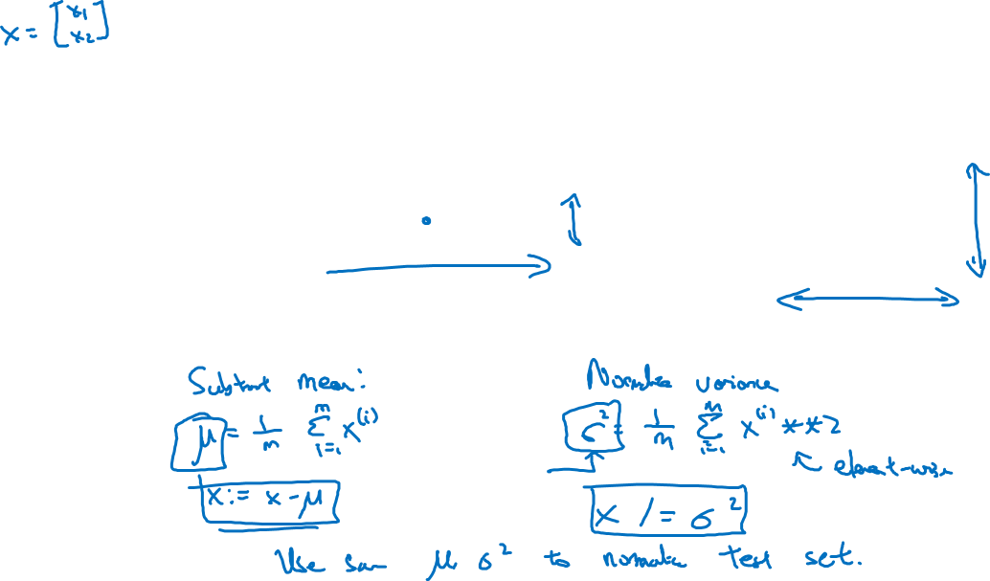
Normalizing training sets
$x_{2}$
$x_{2}$
$$3$$
$x_{2}$
$x_{1}$
$x_{1}$
$x_{1}$
$$5$$

Slide 3
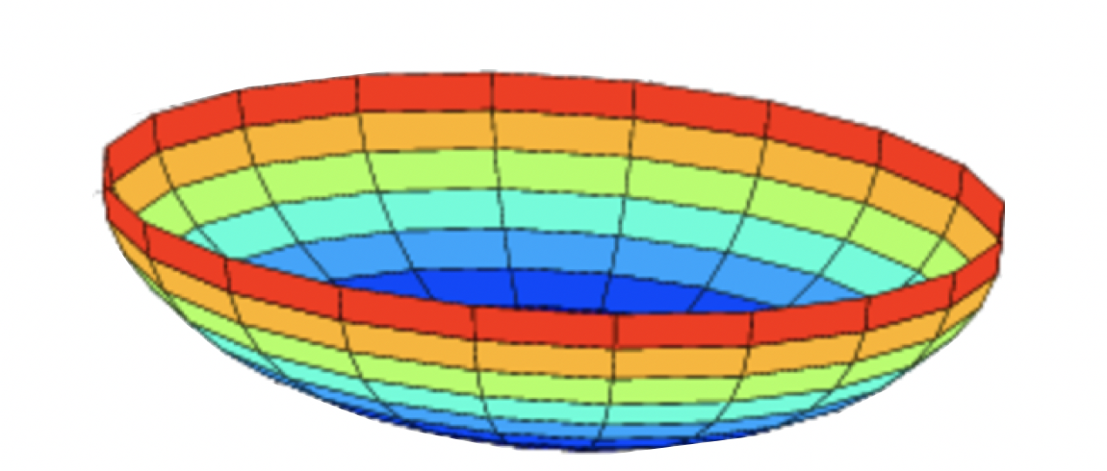



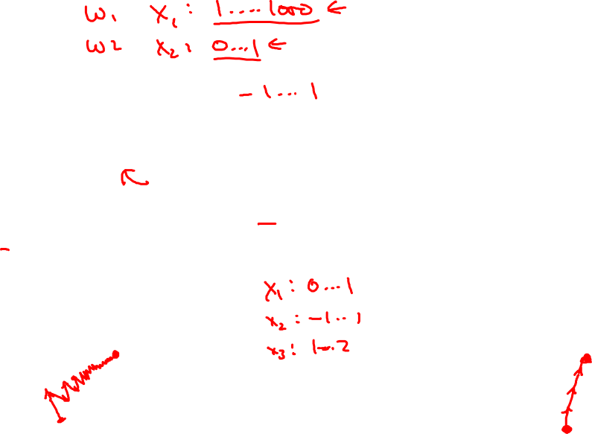











Why normalize inputs?
$$J\left(w,b\right)=\frac{1}{m}$$
$$\sum_{i=1}^{m}{ }$$
$$ℒ ({\hat{y}}^{\left(i\right)},y^{(i)})$$
Unnormalized:
Normalized:
$$J$$
$$J$$
$$w$$
$$w$$
$$b$$
$$b$$
$$b$$
$$b$$
$$w$$
$$w$$

